Slide 1

Machine Learning: Client vs. Server Models
Kevin Ford
Mobile Practice Lead,
Magenic
Level: Intermediate

Slide 2
Examples
https://github.com/Bowman74/VSLiveMLClientAndServerModels

Slide 3
CIMON – IBM AI in space

Slide 4
What is Artificial Intelligence?
“The theory and development of computer systems able to perform tasks normally requiring human intelligence, such as visual perception, speech recognition, decision-making, and translation between languages.” - Oxford Dictionary
Machine learning is the part of AI that deals with programs that can self improve or “learn”.

Slide 5

Why the Current Resurgence in AI?
Advances in Algorithms - Layered deep neural networks
Exponential growth in availability of digital data - Big Data, Cloud storage
Availability of massive amounts of on demand processing power - Cloud computing, Custom processor types

Slide 6
Challenges & Weaknesses of AI
Require huge amounts of clean, accurate & contextual data
Tend to be task specific
Require lots of domain specific knowledge
Cannot handle nuance & causation
Black box

Slide 7
Productivity Paradox
Tech isn’t as impressive as we think
We are not measuring productivity correctly
We haven’t figured out how to use the technologies
It’s about competitive advantage

Slide 8
Are these the same?
Artificial Intelligence
Machine Learning
Bot
Notes:
Artificial Intelligence – doing tasks that normally require human intelligence
Machine learning – subset of AI – comparing large sets of data to find patterns and make educated guesses based on those patterns
Bot – automate predefined tasks

Slide 9

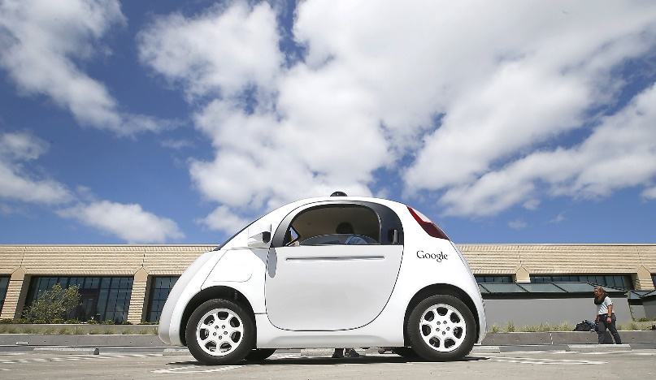
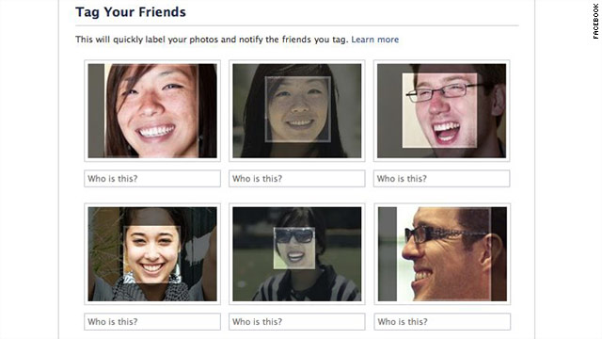

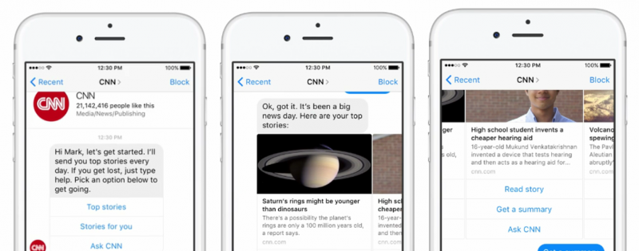
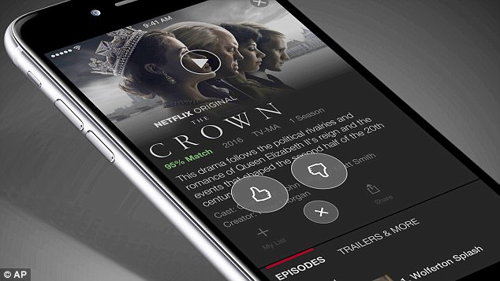
What is it being used for?
Smart personal assistants
Self-driving cars
Social media image recognition
Predictive stock trading
Entertainment
Chatbots

Slide 10
Key Terms
Feature Extraction
Classification
Neural Networks
Reinforcement Learning
Model
Notes:
Feature Extraction – Looking at raw data and pulling out items that may be used to recognize key features about that data that are relevant to understand it. With normal machine learning this is a manual process
Classification – This is where the magic happens. This is where a variety of statistical algorithms run and use the extracted features in different ways to attempt to answer questions about new and similar data that comes in.
Neural Networks – Networks that are designed to work like the human brain. The foundation of deep learning.
Reinforcement learning. – learning by trial and error the best ways to solve a problem
Model – is the product of feature extraction and classification. It can now be used to take newly input data and understand what it is based on the feature extraction and classification of data that has happened before. Reinforcement leaning can be used to improve the model over time.

Slide 11
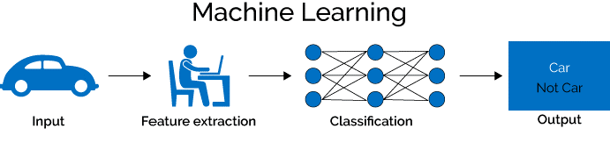
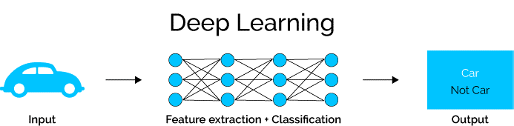
Machine Learning vs Deep Learning
Machine learning is the foundation of AI
Deep learning is the next evolution of machine learning
Both of these are powered by algorithms & ‘vast’ amounts of data

Slide 12
How Models are Made

Slide 13
Required ML Skills for Developers
Coding skills still required to interface with APIs
Understanding of data and how it works
Basic math and statistics skills
Know the algorithms and capabilities that are available
Notes:
Coding still required but you are accessing an API versus writing the logic to solve the problem. i.e. passing it a data model and getting back an answer or prediction.
Basic understanding of data and how it works.
Basic math and stats skills

Slide 14
Prepare for Ambiguity
41.23% Cat
43.3% Cat
35.41% Octopus
35.2% Octopus
23.36% Superman
21.5% Superman

Slide 15
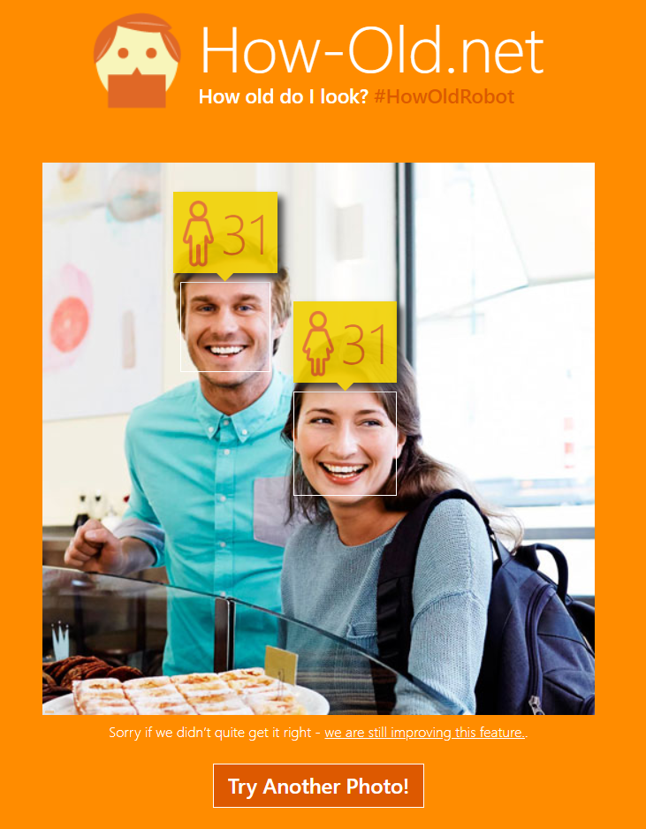
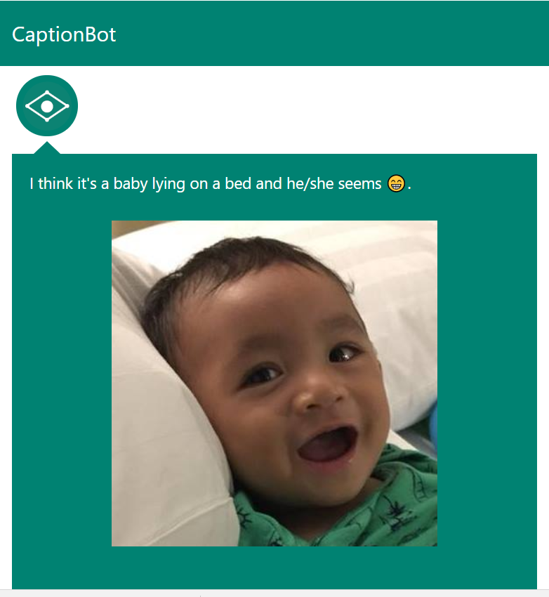
Azure Cognitive Services
Set of APIs, SDKs and services
Jumpstart the development of AI applications
Easy, Flexible and Tested
AI capabilities organized into: Vision, Speech, Language, Search and Knowledge
Notes:
Vision: Algorithms to smartly identify, caption and moderate your pictures
Speech: Enables the integration of speech processing capabilities into any app
Language: Enable services to recognize the meaning of unstructured text or speech
Knowledge: Create rich knowledge resources that can be integrated into apps
Search: Enable apps and services to harness the power of a Web-scale
How-Old.net is the demo site of Microsoft's Project Oxford

Slide 16
Demo

Slide 17
Server Side Vs Client Side Machine Learning
Server Side
Client Side
Large Ecosystem
Vast amounts of data
Computing power
Where models are created
Learning easily transferred to all clients
Large number of options and providers
Work on almost any platform
Works in offline scenarios
Quick and local evaluation of inputs
Supports a wide variety of model formats
No per transaction cost

Slide 18
Machine Learning Frameworks
Notes:
Tensorflow – Backed by google, focuses on deep learning
Keras – open source framework neural network API
SCIKit-Learn – open source framework- started as a google summer of code project
Caffe - Berkeley AI Research project, now open source
Caffe2 – backed by Facebook, derived from Caffe,

Slide 19
Some Server Side Machine Learning Cloud Providers
Notes:
IBM Watson
Azure Machine Learning
AWS Machine Learning
SAP Leonardo
Google Cloud Machine Learning Engine / Tensorflow
BigML

Slide 20
Not All ML Tools are Easy

Slide 21
Azure Machine Learning
Goal: Create code that can take educated guesses
Provides unified environment
ML Studio as Visual UI
Contains industry recognized algorithms
Notes:
Powerful, simple and browser-based AI Service.
Provides a common place for a team to work in a consistent way
ML Studio is a collaborative, drag-and-drop tool you can use to build, test, and deploy predictive analytics

Slide 22
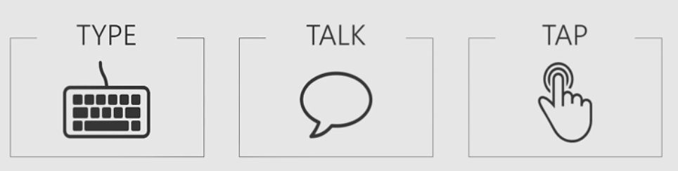
Azure Bot Services
Build, connect, deploy, and manage intelligent bots
Responds to
Bots are gateways to AI services
Notes:
People express natural language query to system.
Azure bot service speeds up development
Take advantage of canvass

Slide 23
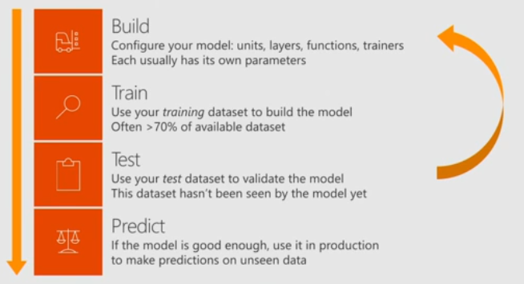
Microsoft Cognitive Toolkit
Open source deep learning toolkit
Easily Ex press Your Own Networks
Production-ready models
Fast, Scalable
Rich API Support
Notes:
Focus on what rather than how
Full of APIs for defining networks, learners, readers, training and evaluation.
Leads competitor especially on GPU. Multi-GPU, multi-server scales out very well.
Large code samples, wide gallery of models

Slide 24
Process to Create model in AMLS
Get some data
Split Data
Train Model
Score Model
Evaluate Model

Slide 25
Demo - Azure Machine Learning

Slide 26
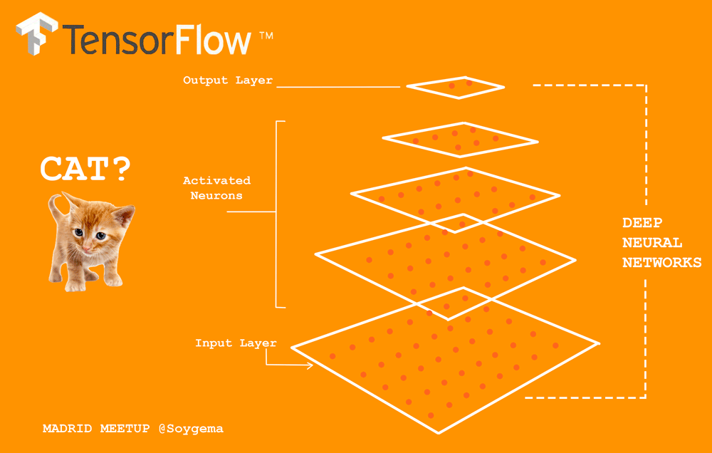
TensorFlow
Used for high performance numerical computation
Open Source software library
Useful for Deep Learning
Tensorboard
Notes:
Computation is approached as dataflow graph.
Nodes = Mathematical Computation, Edges: Multi-Dimensional Arrays (tensors)
TensorBoard data visualization tool packaged with TensorFlow.
Useful to understand the flow of tensors, debugging and evaluation.

Slide 27
Demo – Tensorflow on Google Cloud Machine Learning Engine
Notes:
https://console.cloud.google.com/mlengine/models?project=vsliveml
https://console.cloud.google.com/home/dashboard?project=vsliveml

Slide 28
Some Client Side Machine Learning Options

Slide 29
Client Side ML Flow
Server Side
Client Side ML Framework
Custom
Model
Provided Models
Custom
Model

Slide 30
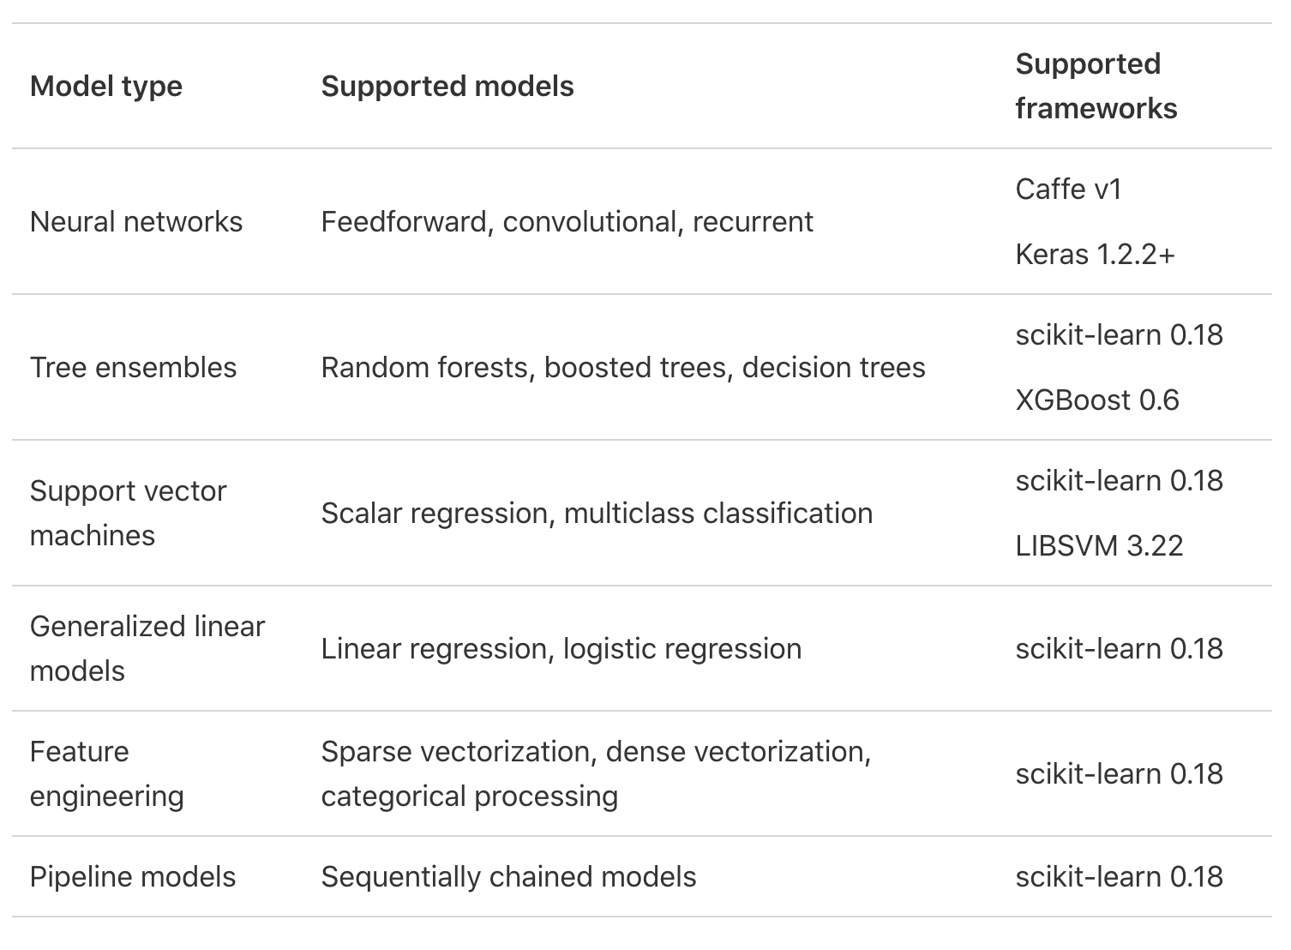
Core ML supported formats

Slide 31
Core ML 2
Create our own models
Image Classification
Natural Language Recognition
Numerical Relationships
Done on a Mac
Faster than previous versions

Slide 32
Demo – Creating a client side ML application

Slide 33
What does the future hold?
AI will begin to step more into corporate functions.
Sales – generating leads, finding quality customers.
Strategic Planning – market analysis for strategy planning.
Corporate Development – automating corporate processes.
Human Resources – recruiting, answering HR questions, personalized learning experiences.
Logistics – distribution center automation.
Development – Refactoring, dare I say it writing apps…

Slide 34
General guidelines
Use server side technologies when
Creating Models
Reinforcement learning
Need lots of data or CPU power
Use client side technologies when
Need to work offline
Too much data to send to the server
Stable models and moderate CPU needs

Slide 35
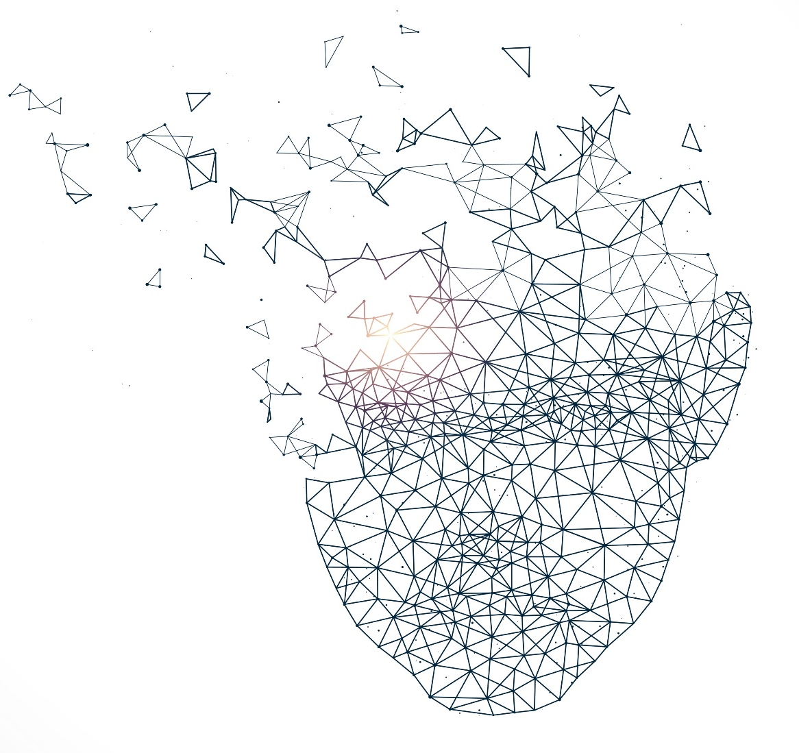
Closing thought
“Three generations ago, many a tinkerer struck it rich by taking a tool and making an electric version. Take a manual pump; electrify it. Find a hand-wringer washer; electrify it. The entrepreneurs didn’t need to generate the electricity; they bought it from the grid and used it to automate the previously manual. Now everything that we formerly electrified we will cognify. There is almost nothing we can think of that cannot be made new, different, or more valuable by infusing it with some extra IQ.”
-Kevin Kelly, Founding exec. editor of Wired Magazine

Slide 36
Q & A
https://github.com/Bowman74/VSLiveMLClientAndServerModels

